Slide 1
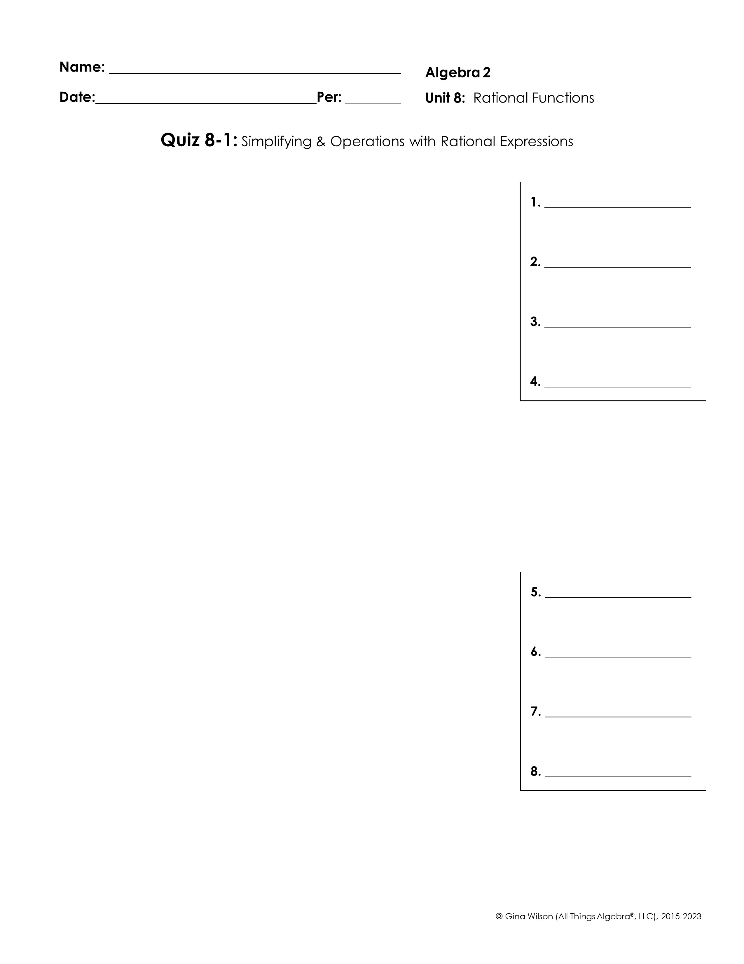
Simplify each expression.
1.
2.
3.
4.
Find each product or quotient.
5.
6.
7.
8.

Slide 2
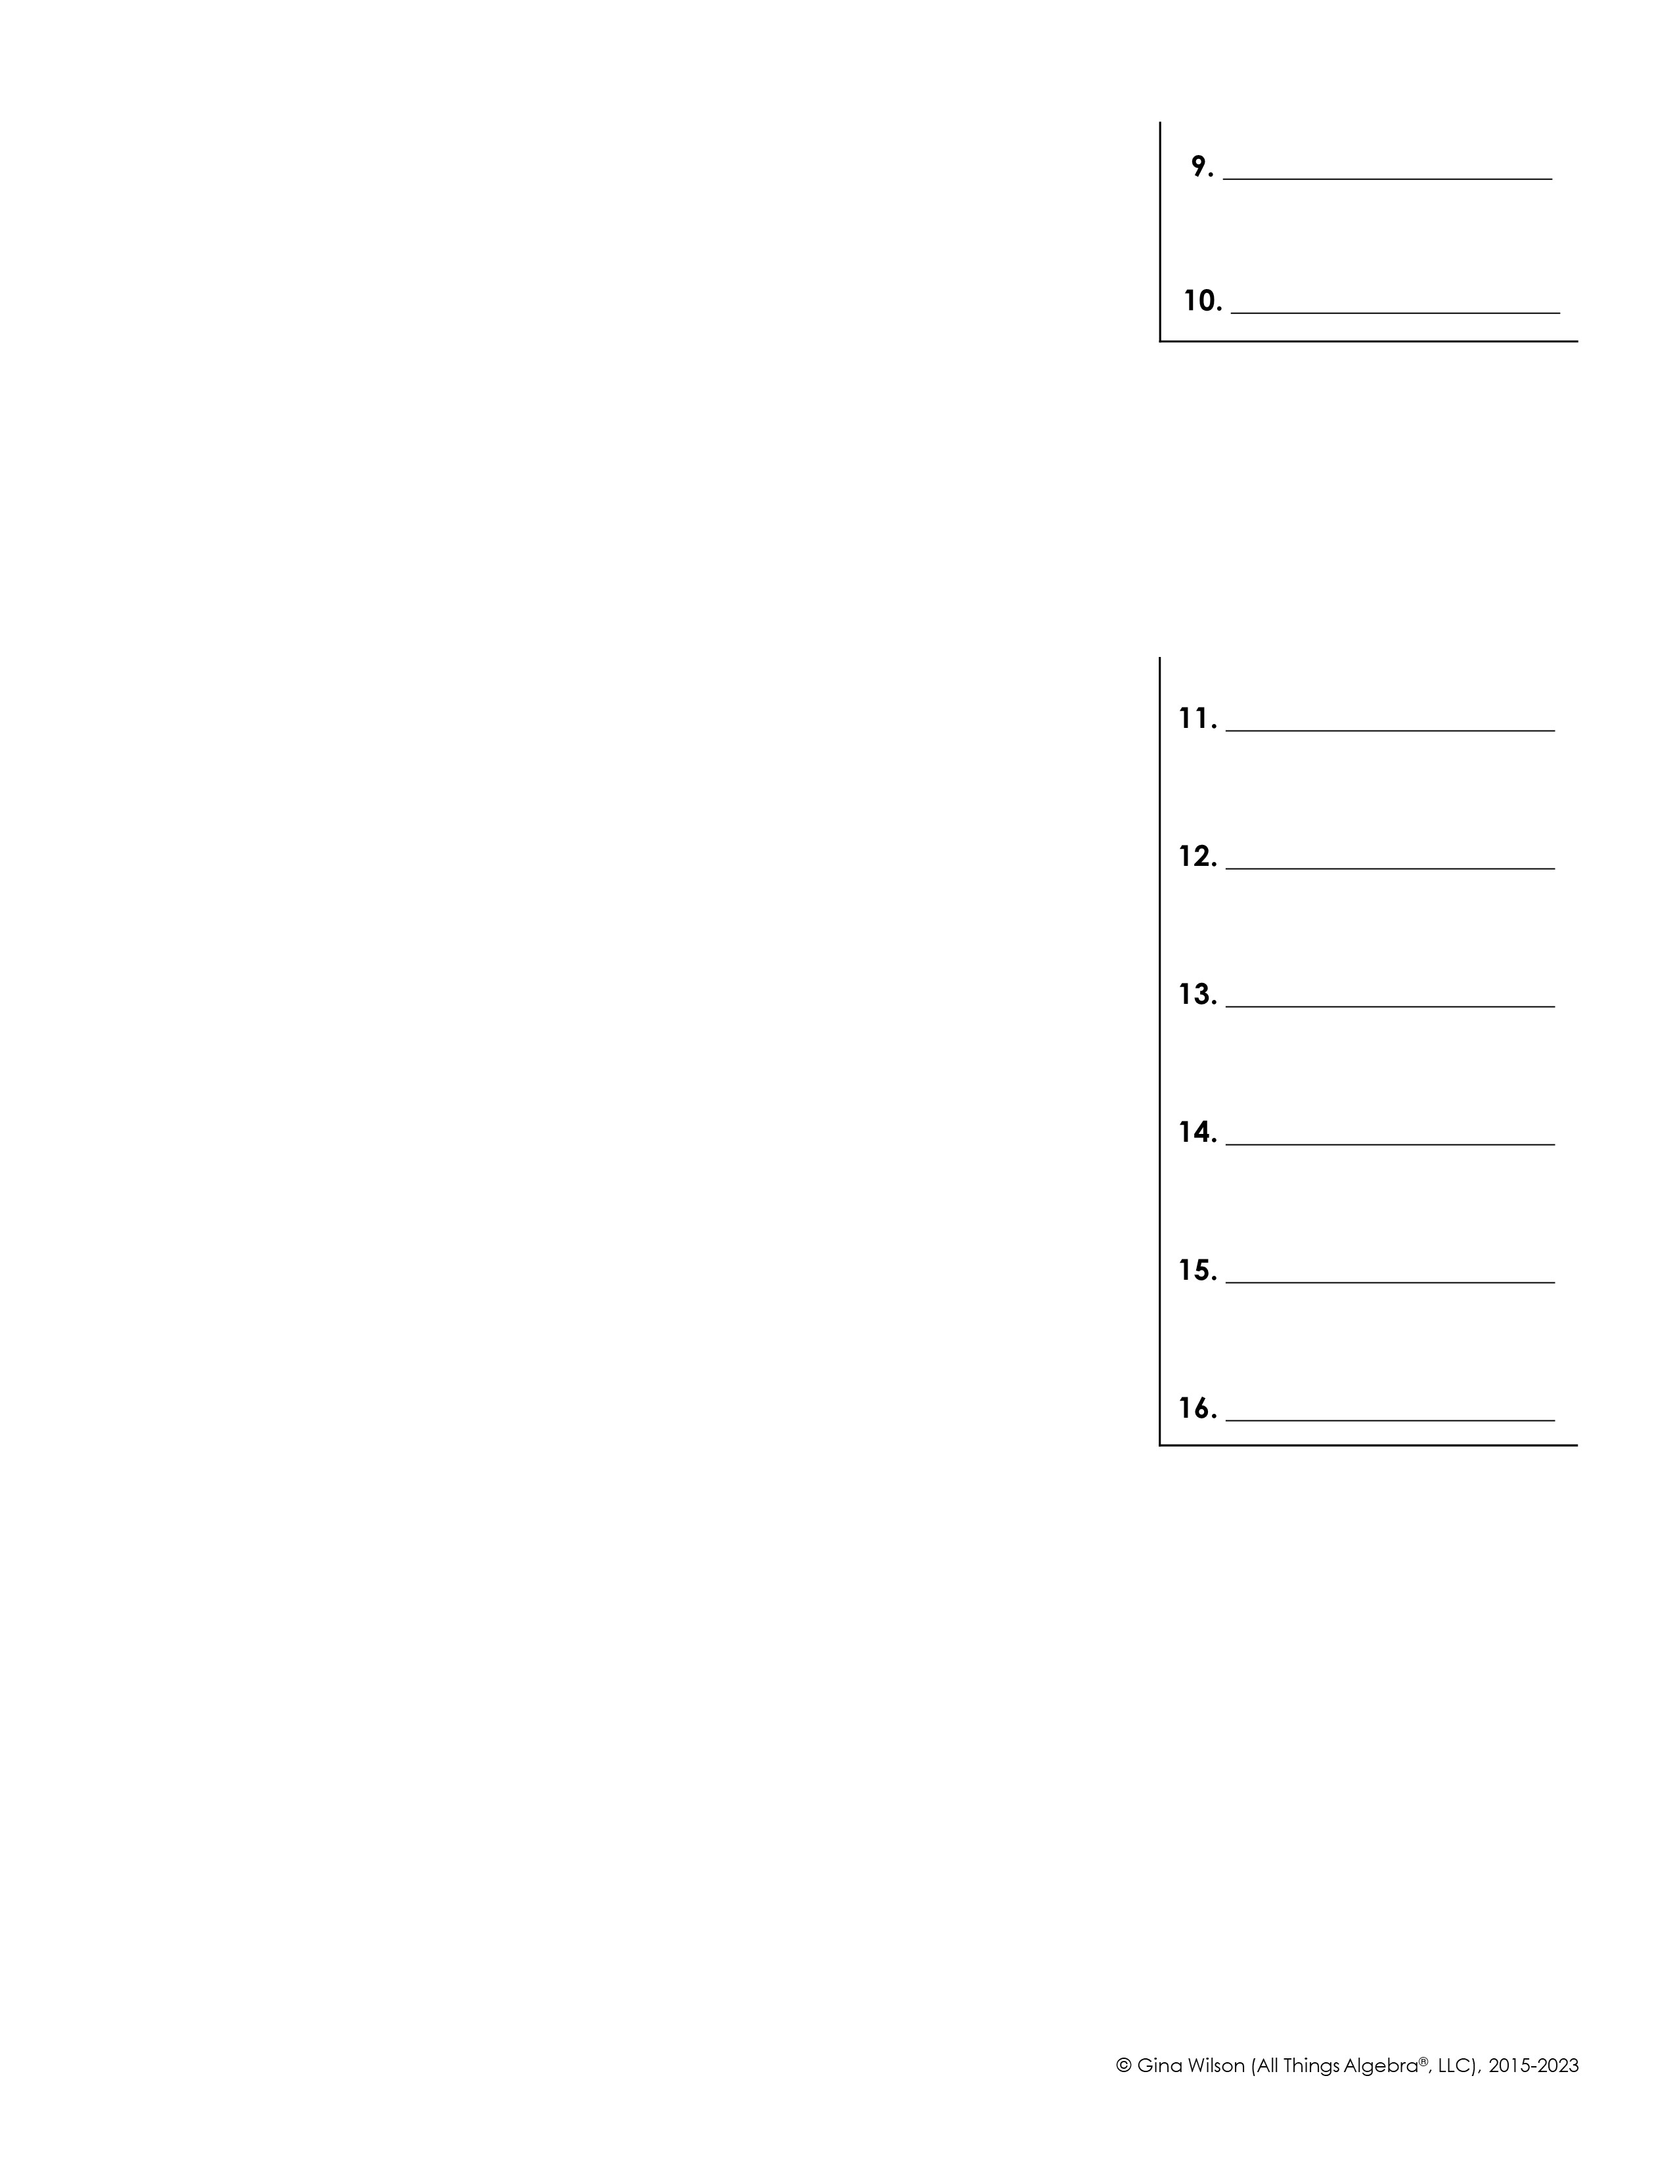
9.
10.
Find each sum or difference.
11.
12.
13.
14.
15.
16.

